Slide 1


Slide 2
OBJECTIVE ASSESSMENT
PREPARED BY:
MUSKAN PRADHAN
ROLL NO: 15
BNS 2ND YEAR, 17TH BATCH
TU,IOM

Slide 3
GENERAL OBJECTIVE
At the end of session, BNS 1st year students will be able to describe about objective assessment and methods of pain relief intervention.

Slide 4
SPECIFIC OBJECTIVE
At the end of session, BNS 1st year students will be able to:
describe the objective assessment of pain.
list the pain management techniques.
explain the pharmacological pain management .

Slide 5
describe about NSAIDS
describe about opioids
describe about adjuvant drugs
explain about WHO analgesics ladder of pain management
explain about methods and routes of drug administration
explain the nursing principle for administrating analgesics

Slide 6
OBJECTIVE ASSESSMENT
Vital signs including physical examination and observation for non verbal response to pain.

Slide 7
PAIN MANAGEMENT TECHNIQUES

Slide 8
THERAPEUTIC MEASURES TO RELIEVE PAIN
The nature of pain and the extent to which if affects a person's wellbeing determine the choice of pain relief interventions.
Pain therapy requires individualized approach.
The nurse, the client and the family must be partners in using pain control measures.
Generally, the least invasive or safest therapy should be tried first.

Slide 9
Teaching clients about the pain experience reduces anxiety and helps clients achieve a sense of control.
When a person develops pain or other symptoms of discomfort, there are non- pharmacological as well as the pharmacological strategies to be offered

Slide 10
Different types of interventions (pharmacological and /or non- pharmacological) are used for pain relief with the following purposes:
To alleviate or decrease pain.
To increase function.
To improve the quality of life.

Slide 11
TYPES OF PAIN MANAGEMENT TECHNIQUE
Pharmacological Pain Management
Non Pharmacological Pain Management

Slide 12
PHARMACOLOGICAL PAIN RELIEF INTERVENTIONS
There are several pharmacological agents for acute and several pain that provide pain relief and require a physician's order to administer.
The nurse's judgment in the use and management of these medication help ensure the best pain relief possible.

Slide 13
Analgesic
NSAIDs
Opioids
Adjuvants

Slide 14
WHO ANALGESIC LADDER FOR PAIN MANAGEMENT

Slide 15
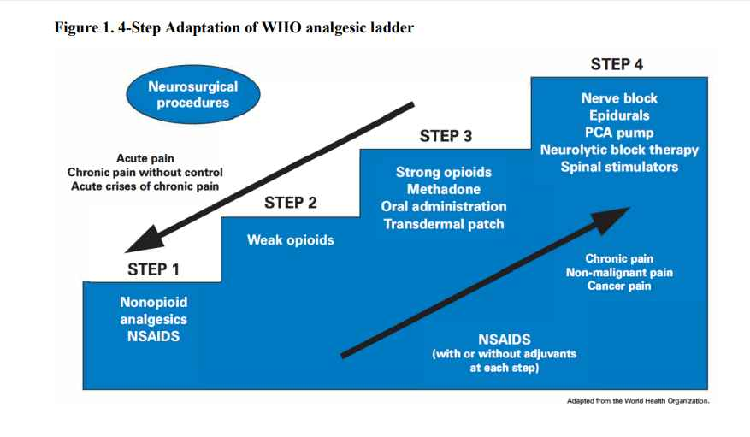

Slide 16
Step One
Acetaminophen and the non- steroidal anti -inflammatory drugs (NSAIDs) including acetylsalicylic acid (ASA) is the mainstay of step one of the WHO analgesic ladder for the management of mild pain.
They may be dosed up to recommended maximums.
Many are available without prescription.

Slide 17
Step Two
Several opioids analgesics are available in combination with either acetaminophen or ASA are commonly used to manage moderate pain.

Slide 18
Propoxyphene , tramadol and codeine have been termed "weak" opioids because, in combination, they have a ceiling to their analgesic potential due to the maximum amounts of acetaminophen or ASA that can be administered per 24 hours.(i.e. 4gm acetaminophen per 24 hours)

Slide 19
They may be dosed up to recommended maximums.
If pain persists, or increases, despite a maximum dose of a step two drug, a step three drugs should be prescribed instead.

Slide 20
Step Three
The pure agonist opioids analgesics comprise step of the WHO analgesic ladder.
Morphine is the prototypical drugs because of its ease of administration and wide availability.
Many patients with chronic pain are best managed with an appropriately strong opioids that is combined with one or more co - analgesics.

Slide 21
In contrast with the step- one and step-2 analgesics, there is no ceiling effect or upper limit to the dose of opioids to relieve pain.

Slide 22
Step Four
Several studies of the WHO 3- step ladder have demonstrated that its application results in the adequate control of up to 90% of patients with cancer pain.
Several authors have informally invoked "step four" to indicate approaches that should be reversed for patients whose pain is not controlled by competent use of the analgesic approaches outlined in the first three steps.

Slide 23
Intraspinal administration of opioids analgesics either epidurally or intrathecally may be required in selected patients. Neuroablative techniques such as peripheral neurolytic blockade, ganglionic blockade and cingulotomy may be appropriate in highly selected patients.
Notes:
Peripheral neurolytic blockade: regional anaesthesi related to injecting the medicine near the major nerves that causes the interruption in pain message transmission.
Ganglionic blockade:type of medication that inhibits transmission between preganglionic and postganglionic neurons in the autonomic nervous system.
Cingulotomy is a neurosurgical procedure in which doctors use specialized tools to inactivate brain tissue in anterior cingulate area(part of brain associated with feeling chronic pain)

Slide 24
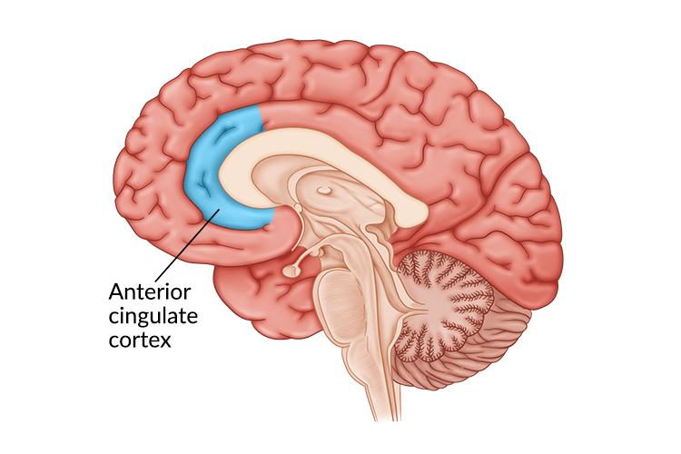

Slide 25
METHODS AND ROUTE OF DRUG ADMINISTRATION
Patient - controlled analgesia(PCA) :
It is a drug delivery system that allow client to safe administer opioids with minimal risk of overdose.
The goal is to maintain a constant plasma level of analgesic. A safe method for post- operative and cancer pain management that most patient prefers.
Notes:
Local anesthesia: lidocaine, procaine, bupivaccine

Slide 26
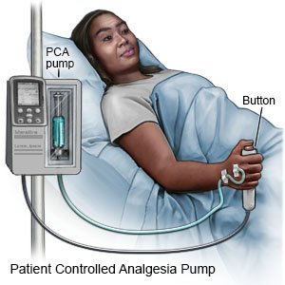

Slide 27
b) Local analgesic infusion pump
This method is use to avoid systemic effect of oral analgesics following orthopedic surgery through catheter from the attached with a pump containing local anesthetics.

Slide 28
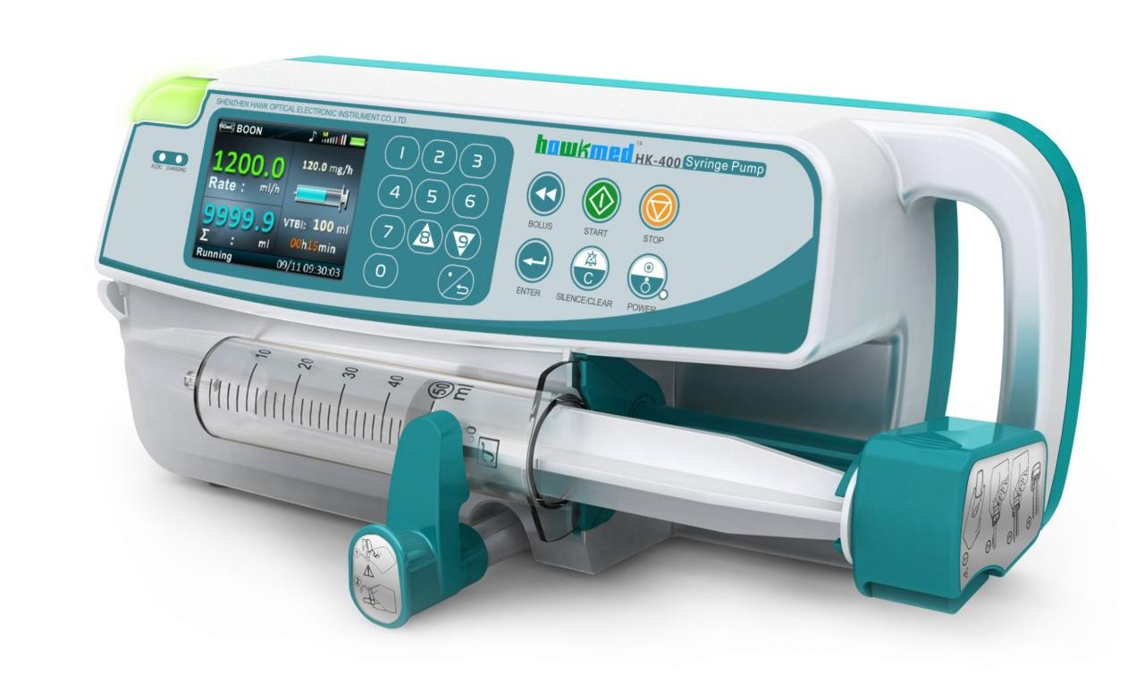
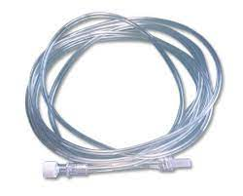

Slide 29
c) Topical analgesic and anesthetics: EMLA (eutectic mixture of local anesthesia) I/V site, Lidoderm patch - cutaneous neuropathic pain.
d) Local anesthesia- inhibit nerve conduction
e) Regional anesthesia: epidural anesthesia, pudendal block, spinal anesthesia
Notes:
A pudendal nerve block is an injection of medication close to your pudendal nerve in your pelvic region to provide temporary pain relief.

Slide 30
NURSING PRINCIPLE FOR ADMINISTRATING ANALGESICS
Know the clients previous response to analgesics :
Allergies, risk factors for example, history of sleep apnea.
Previous dose and routes- to avoid under treatment.
Whether relief was obtained.
Effectiveness- opioids / non - opioids

Slide 31
2. Select proper medications when more than one is ordered:
Use monopod analgesics or opioid combination drugs for mild- moderate pain.
Know that nonopioids can be given with opioids.
In older adults, avoid combination of opioids.
Remember that morphine and hydromorphine are the opioids of choice for long -term management of severe pain

Slide 32
Know that intravenous medications act quicker and can relieve severe acute pain within 1 hour, oral within 2 hour.
Understand that I/M analgesics for severe pain because such combinations treat pain peripherally and centrally.

Slide 33
3. Know the accurate doses- adjust doses
4. Assess the right time and interval for administration for example before increases severity, around the clock is the best, before pain producing procedures.

Slide 34


Slide 35
SUMMARY
Fill in the blanks (0.5 * 2 = 1)
1. Full form of PCA is ……..
Answer: Patient- Controlled Analgesia

Slide 36
2. Objective assessment includes assessment of …… and …..
Answer: Behavioral Effect And Physiologic Response

Slide 37
3. What are the pharmacological intervention of pain management ?

Slide 38
ASSIGNMENT
Write short note about pharmacological management of pain assessment.
Date of submission: 2080/11/03

Slide 39
PLAN FOR NEXT CLASS
We will discuss about the surgical management and non-pharmacological management of pain.

Slide 40
REFERENCES
Acharya K D ,Pokharel D K ,”Nursing Concepts And Principles” 2nd Ed, Jupiter Publishers and Distributor Pvt.Ltd.
Mandal G.N, “Nursing Concept ”, 1st edition,(2005),Makalu books and Stationers, Page no: 804-806
Rai L, (2015), “Nursing Concepts Theories and Principles”, 3rd Edition, Tara Books and Stationary, Chhatrapati, Kathmandu. Page no :205 - 211

Slide 41
S.C Suzanne, B G Brenda, Brunner and Suddarths “Textbook of Medical -surgical Nursing”, 3rd edition ,Wolters Kluwer pvt Ltd.
Sharma M, “Nursing Concepts and Principles”,2nd Ed, Medhavi publication , Page no: 167, 174- 182
https://www.webmd.com/pain-management/guide/pain-types-and-classifications

Slide 42


